Slide 1

CSc11300- Programming languages Lecture 1

Slide 2
Course Overview
About the Instructor: Ahmet Yuksel
E-mail: ayuksel@ccny.cuny.edu
Office hours: Tue 11:00-12:00 NAC 7/101
Section 1 Tuesday 9:30 - 10:45 AM
Section 2 Tuesday 12:30 - 1:45 PM
Section 3 Tuesday 2:00 - 3:15 PM
Credit Hours: 1
Prerequisite(s): CSc 10300 Introduction to Computing for Majors

Slide 3
Course Description
This course is designed to develop understanding of and fluency in current and important programming languages.
Specifically, this course aims to develop the student’s fluency in Python.
The course is intended for those who have already learned object-oriented concepts in at least one programming language.
A series of programming projects is an essential component of the course.

Slide 4
Course Goals
To provide students with skills in applying essential features to implement, test, and debug computer programs in Python for problem solving.
To provide students with basic knowledge and understanding of object-oriented design and implementation using Pythons class concept and type safety.

Slide 5
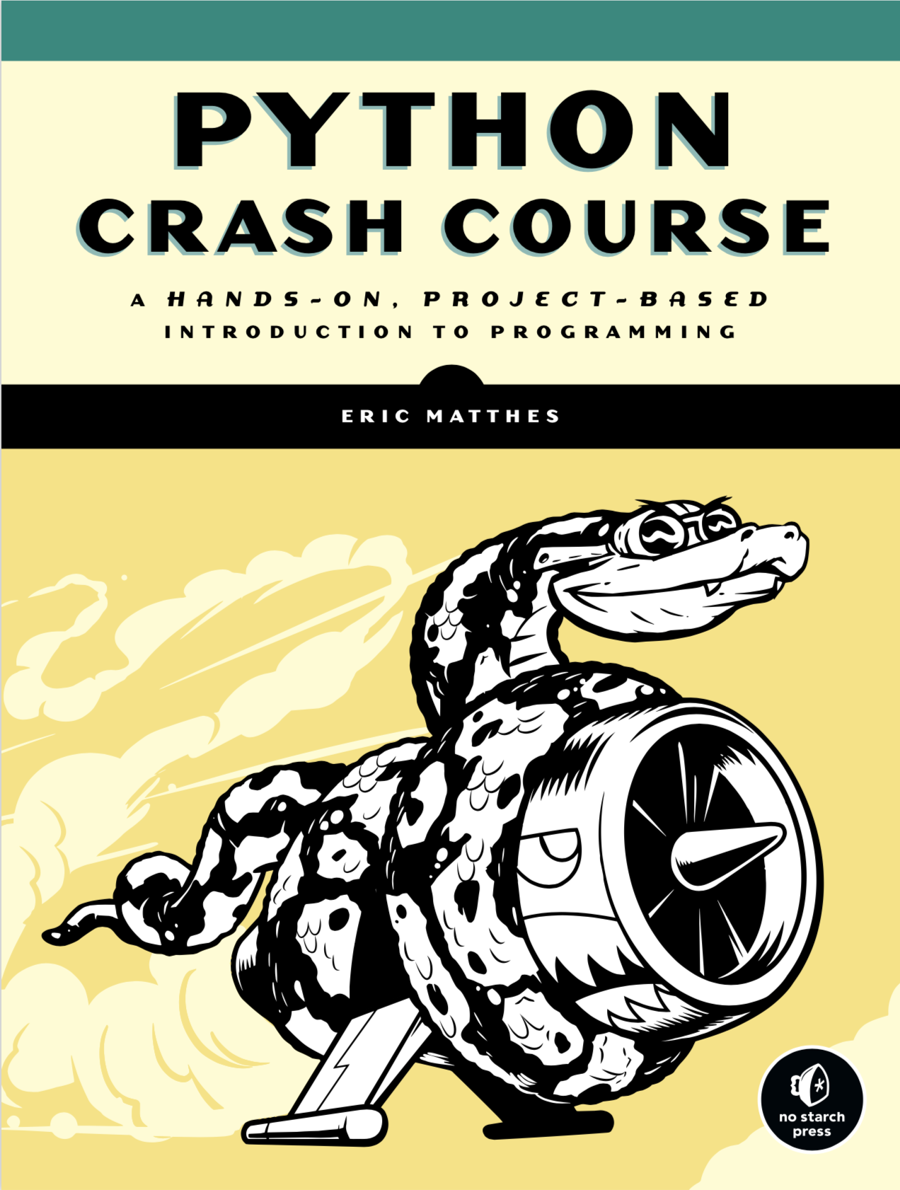
Textbook (Not Mandatory)
Python Crash Course
A hands-on, Project-Based Introduction to Programming
By Eric Matthes

Slide 6
Textbook (Another Option)
Think Python How to Think Like a Computer Scientist 2nd Edition
Green Tea Press Needham, Massachusetts
Available online. For free.
http://greenteapress.com/thinkpython2/thinkpython2.pdf

Slide 7
Grade Distribution
Class exercises 25%
Project 1 or Midterm Exam 30%
Project 2 or Final Exam 35%
Attendance 5%
Participation 5%

Slide 8
Academic planner, Academic honesty
See academic calendar for tracking the deadlines.
No collaboration is allowed for coding projects. Any kind of cheating such as internet copy-paste, submitting same project with anyone else by changing the structure, or getting/hiring someone to do the coding for you will be punishable by penalties according to CUNY-wide policies.

Slide 9
Topics
Python programming language and environment

Slide 10
Topics
Python programming language and environment
Basic syntax – variables, expressions, and statements

Slide 11
Topics
Python programming language and environment
Basic syntax – variables, expressions, and statements
Functions

Slide 12
Topics
Python programming language and environment
Basic syntax – variables, expressions, and statements
Functions
Conditionals and recursion

Slide 13
Topics
Python programming language and environment
Basic syntax – variables, expressions, and statements
Functions
Conditionals and recursion
Iterations

Slide 14
Topics
Python programming language and environment
Basic syntax – variables, expressions, and statements
Functions
Conditionals and recursion
Iterations
Strings

Slide 15
Topics
Python programming language and environment
Basic syntax – variables, expressions, and statements
Functions
Conditionals and recursion
Iterations
Strings
Lists

Slide 16
Topics
Python programming language and environment
Basic syntax – variables, expressions, and statements
Functions
Conditionals and recursion
Iterations
Strings
Lists
Dictionaries

Slide 17
Topics
Python programming language and environment
Basic syntax – variables, expressions, and statements
Functions
Conditionals and recursion
Iterations
Strings
Lists
Dictionaries
Files

Slide 18
Topics
Python programming language and environment
Basic syntax – variables, expressions, and statements
Functions
Conditionals and recursion
Iterations
Strings
Lists
Dictionaries
Files
Classes – objects, functions, methods, inheritance

Slide 19
Chapter 1 The way of the program

Slide 20
The way of the program
The goal of this course’s textbook is to teach you to think like a computer scientist.
The single most important skill for a computer scientist is problem solving.
Problem solving means the ability to formulate problems, think creatively about solutions, and express a solution clearly and accurately.

Slide 21
1.1 The Python programming language
The programming language you will be learning in this course is Python3.
Python is an example of a high-level language; other high-level languages you might have heard of are C, C++, Perl, and Java.
As you might infer from the name “high-level language,” there are also low level languages,
What’s the difference between two?

Slide 22
1.1 The Python programming language
The programming language you will be learning in this course is Python3.
Python is an example of a high-level language; other high-level languages you might have heard of are C, C++, Perl, and Java.
As you might infer from the name “high-level language,” there are also low level languages;
“machine languages” or “assembly laguages”.
What’s the difference between two?

Slide 23
The Python programming language
Two kinds of programs process high-level languages into low-level languages: interpreters and compilers.

Slide 24
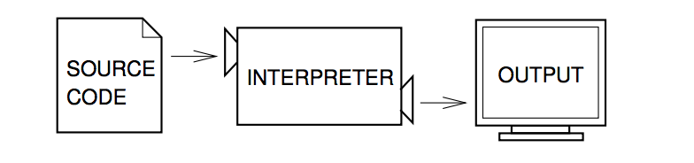
Interpreter
An interpreter reads a high-level program and executes it, meaning that it does what the program says.
It processes the program a little at a time, alternately reading lines and performing computations

Slide 25
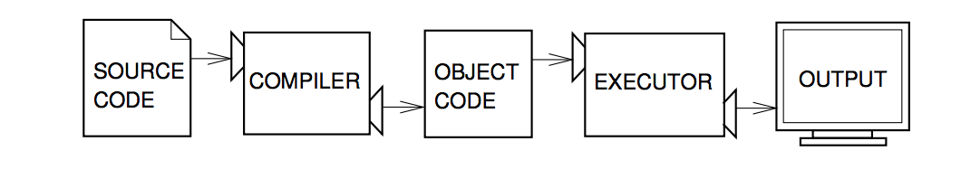
Compiler
A compiler reads the program and translates it completely before the program starts running.
In this case, the high-level program is called the source code, and the translated program is called the object code or the executable.
Once a program is compiled, you can execute it repeatedly without further translation.

Slide 26
The Python programming language
Which one does Python belong to?
Interpreted or Compiled?

Slide 27
The Python programming language
Python is considered an interpreted language because Python programs are executed by an interpreter.
There are two ways to use the interpreter: command line mode and script mode.
In command-line mode, you type Python programs and the interpreter prints the result:

Slide 28


Python - Script
Alternatively, we can write a program in a file and use the interpreter to execute the contents of the file.
Such a file is called a script. For example, we can use a text editor to create a file named latoya.py with the following contents:
To execute the program, we have to tell the interpreter the name of the script:

Slide 29
Command line
Most of our exercises will be on command line.
But when necessary script will be used as well.
Working on the command line is convenient for program development and testing, because we can type programs and execute them immediately.
Once we have a working program, we can store it in a script so we can execute or modify it in the future.

Slide 30
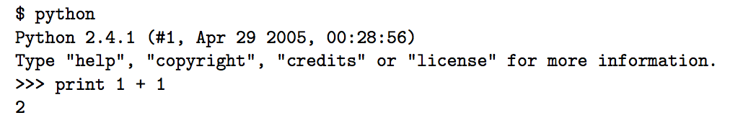
The Python programming language
The first line of this example is the command that starts the Python interpreter.
The next two lines are messages from the interpreter.
The third line starts with >>>, which is the prompt the interpreter uses to indicate that it is ready.
We typed print 1 + 1, and the interpreter replied 2.

Slide 31
1.2 What is a program?

Slide 32
1.2 What is a program?
A program is a sequence of instructions that specifies how to perform a computation.
The computation might be something mathematical, such as solving a system of equations or finding the roots of a polynomial, but it can also be a symbolic computation, such as searching and replacing text in a document or compiling a program.

Slide 33
1.2 What is a program?
The details look different in different languages, but a few basic instructions appear in just about every language:

Slide 34
1.2 What is a program?
The details look different in different languages, but a few basic instructions appear in just about every language:
input: Get data from the keyboard, a file, or some other device.

Slide 35
1.2 What is a program?
The details look different in different languages, but a few basic instructions appear in just about every language:
input: Get data from the keyboard, a file, or some other device.
output: Display data on the screen or send data to a file or other device.

Slide 36
1.2 What is a program?
The details look different in different languages, but a few basic instructions appear in just about every language:
input: Get data from the keyboard, a file, or some other device.
output: Display data on the screen or send data to a file or other device.
math: Perform basic mathematical operations like addition and multiplication.

Slide 37
1.2 What is a program?
The details look different in different languages, but a few basic instructions appear in just about every language:
input: Get data from the keyboard, a file, or some other device.
output: Display data on the screen or send data to a file or other device.
math: Perform basic mathematical operations like addition and multiplication.
conditional execution: Check for certain conditions and execute the appropriate sequence of statements.

Slide 38
1.2 What is a program?
The details look different in different languages, but a few basic instructions appear in just about every language:
input: Get data from the keyboard, a file, or some other device.
output: Display data on the screen or send data to a file or other device.
math: Perform basic mathematical operations like addition and multiplication.
conditional execution: Check for certain conditions and execute the appropriate sequence of statements.
repetition: Perform some action repeatedly, usually with some variation.

Slide 39
1.3 What is debugging?

Slide 40
1.3 What is debugging?
Programming is a complex process, and because it is done by human beings, it often leads to errors.
For whimsical reasons, programming errors are called bugs and the process of tracking them down and correcting them is called debugging.

Slide 41
1.3 What is debugging?
Three kinds of errors can occur in a program:

Slide 42
1.3 What is debugging?
Three kinds of errors can occur in a program:
syntax errors

Slide 43
1.3 What is debugging?
Three kinds of errors can occur in a program:
syntax errors
runtime errors

Slide 44
1.3 What is debugging?
Three kinds of errors can occur in a program:
syntax errors
runtime errors
semantic errors

Slide 45
1.3 What is debugging?
Three kinds of errors can occur in a program:
syntax errors - refers to the structure of a program and the rules about that structure. For example, in English, a sentence must begin with a capital letter and end with a period. this sentence contains a syntax error.
runtime errors
semantic errors

Slide 46
1.3 What is debugging?
Three kinds of errors can occur in a program:
syntax errors - refers to the structure of a program and the rules about that structure. For example, in English, a sentence must begin with a capital letter and end with a period. this sentence contains a syntax error.
runtime errors - the error does not appear until you run the program. These errors are also called exceptions because they usually indicate that something exceptional (and bad) has happened.
semantic errors

Slide 47
1.3 What is debugging?
Three kinds of errors can occur in a program:
syntax errors - refers to the structure of a program and the rules about that structure. For example, in English, a sentence must begin with a capital letter and end with a period. this sentence contains a syntax error.
runtime errors - the error does not appear until you run the program. These errors are also called exceptions because they usually indicate that something exceptional (and bad) has happened.
semantic errors - If there is a semantic error in your program, it will run successfully, in the sense that the computer will not generate any error messages, but it will not do the right thing. It will do something else. Specifically, it will do what you told it to do.

Slide 48
Experimental debugging
Debugging is like an experimental science.
Once you have an idea what is going wrong, you modify your program and try again.
If your hypothesis was correct, then you can predict the result of the modification, and you take a step closer to a working program.
If your hypothesis was wrong, you have to come up with a new one.

Slide 49
1.4 Formal and natural languages

Slide 50
1.4 Formal and natural languages
Natural languages

Slide 51
1.4 Formal and natural languages
Natural languages
Formal languages

Slide 52
1.4 Formal and natural languages
Natural languages: are the languages that people speak, such as English, Spanish, and French. They were not designed by people, they evolved naturally.
Formal languages

Slide 53
1.4 Formal and natural languages
Natural languages: are the languages that people speak, such as English, Spanish, and French. They were not designed by people, they evolved naturally.
Formal languages: Formal languages are languages that are designed by people for specific applications. For example, chemists use a formal language to represent the chemical structure of molecules.

Slide 54
1.4 Formal and natural languages
Natural languages: are the languages that people speak, such as English, Spanish, and French. They were not designed by people, they evolved naturally.
Formal languages: Formal languages are languages that are designed by people for specific applications. For example, chemists use a formal language to represent the chemical structure of molecules.
And most importantly:

Slide 55
1.4 Formal and natural languages
All of the programming languages are formal languages that have been designed to express computations.

Slide 56
Formal languages con’t
Formal languages tend to have strict rules about syntax.
For example, 3+3 = 6 is a syntactically correct mathematical statement, but 3=+6$ is not.
H2O is a syntactically correct chemical name, but 2Zz is not. Syntax rules come in two flavors, pertaining to tokens and structure.
Tokens are the basic elements of the language, such as words, numbers, and chemical elements.

Slide 57
An exercise…
Write a well-structured English sentence with invalid tokens in it. Then write another sentence with all valid tokens but with invalid structure.

Slide 58
An exercise
Answer:
Bad Token = 'The m@n jump3d over th3 m00n.’
Bad Syntax = 'Moon over jumped man the the.'

Slide 59
Parsing
When you read a sentence in English or a statement in a formal language, you have to figure out what the structure of the sentence is (although in a natural language you do this subconsciously).
This process is called parsing.
For example, when you hear the sentence, “The other shoe fell,” you understand that “the other shoe” is the subject and “fell” is the predicate. Once you have parsed a sentence, you can figure out what it means, or the semantics of the sentence. Assuming that you know what a shoe is and what it means to fall, you will understand the general implication of this sentence.

Slide 60
Differences between formal and natural languages
ambiguity: Natural languages are full of ambiguity, which people deal with by using contextual clues and other information. Formal languages are designed to be nearly or completely unambiguous, which means that any statement has exactly one meaning, regardless of context.

Slide 61
Differences between formal and natural languages
ambiguity: Natural languages are full of ambiguity, which people deal with by using contextual clues and other information. Formal languages are designed to be nearly or completely unambiguous, which means that any statement has exactly one meaning, regardless of context.
redundancy: In order to make up for ambiguity and reduce misunderstandings, natural languages employ lots of redundancy. As a result, they are often verbose. Formal languages are less redundant and more concise.

Slide 62
Differences between formal and natural languages
ambiguity: Natural languages are full of ambiguity, which people deal with by using contextual clues and other information. Formal languages are designed to be nearly or completely unambiguous, which means that any statement has exactly one meaning, regardless of context.
redundancy: In order to make up for ambiguity and reduce misunderstandings, natural languages employ lots of redundancy. As a result, they are often verbose. Formal languages are less redundant and more concise.
literalness: Natural languages are full of idiom and metaphor. If I say, “The other shoe fell,” there is probably no shoe and nothing falling. Formal languages mean exactly what they say.

Slide 63
Differences between formal and natural languages con’t
In some ways, the difference between formal and natural language is like the difference between poetry and prose, but more so:

Slide 64
Differences between formal and natural languages con’t
In some ways, the difference between formal and natural language is like the difference between poetry and prose, but more so:
Poetry: Words are used for their sounds as well as for their meaning, and the whole poem together creates an effect or emotional response. Ambiguity is not only common but often deliberate.

Slide 65
Differences between formal and natural languages con’t
In some ways, the difference between formal and natural language is like the difference between poetry and prose, but more so:
Poetry: Words are used for their sounds as well as for their meaning, and the whole poem together creates an effect or emotional response. Ambiguity is not only common but often deliberate.
Prose: The literal meaning of words is more important, and the structure contributes more meaning. Prose is more amenable to analysis than poetry but still often ambiguous.

Slide 66
Differences between formal and natural languages con’t
In some ways, the difference between formal and natural language is like the difference between poetry and prose, but more so:
Poetry: Words are used for their sounds as well as for their meaning, and the whole poem together creates an effect or emotional response. Ambiguity is not only common but often deliberate.
Prose: The literal meaning of words is more important, and the structure contributes more meaning. Prose is more amenable to analysis than poetry but still often ambiguous.
Programs: The meaning of a computer program is unambiguous and literal, and can be understood entirely by analysis of the tokens and structure.

Slide 67


1.5 The first program
Traditionally, the first program written in a new language is called “Hello, World!” because all it does is display the words.
“Hello, World!” In Python, it looks like this:
This is an example of a print statement, which doesn’t actually print anything on paper. It displays a value on the screen. In this case, the result is the words:

Slide 68
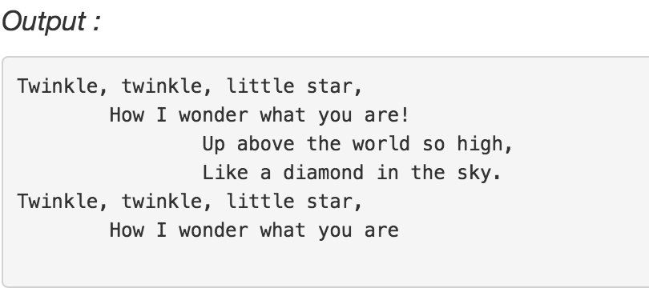
An Exercise
Write a Python program to print the following string in a specific format (see the output).
Sample String : "Twinkle, twinkle, little star, How I wonder what you are! Up above the world so high, Like a diamond in the sky. Twinkle, twinkle, little star, How I wonder what you are"

Slide 69
Hints…
To go to the next line we use: \n
To leave space between: \t

Slide 70
solution
print("Twinkle, twinkle, little star, \n\tHow I wonder what you are! \n\t\tUp above the world so high, \n\t\tLike a diamond in the sky. \nTwinkle, twinkle, little star, \n\tHow I wonder what you are")

Slide 71
Another execise
Write a Python program to display the current date and time.
Sample Output : Current date and time : 2014-07-05 14:34:14

Slide 72
solution
import datetime
now = datetime.datetime.now()
print ("Current date and time : ")
print (now.strftime("%Y-%m-%d %H:%M:%S"))

Slide 73
Exercise
Write a Python program which accept the radius of a circle from the user and compute the area.

Slide 74
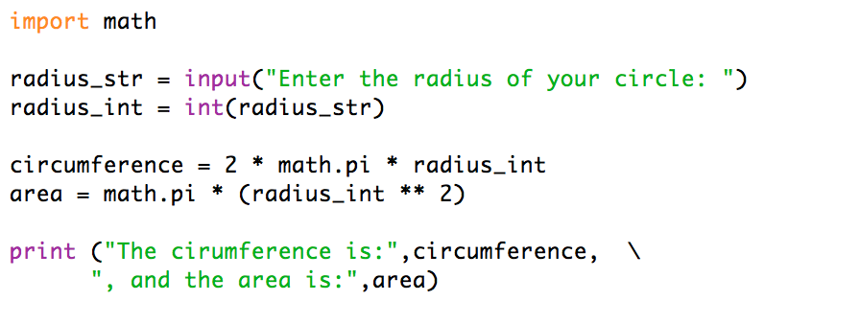
solution

Slide 75
Exercise
Print first and last name in reverse order with a space between them
Input: Ahmet Yuksel
Output: Hello Yuksel Ahmet

Slide 76
fname = input("Input your First Name : ")
lname = input("Input your Last Name : ")
print ("Hello " + lname + " " + fname)

Slide 77
Exercise
Write a Python program which accepts a sequence of comma-separated numbers from user and generate a list and a tuple with those numbers.
Sample data : 3, 5, 7, 23 Output : List : ['3', ' 5', ' 7', ' 23'] Tuple : ('3', ' 5', ' 7', ' 23')

Slide 78
Solution
values = input("Input some comma seprated numbers : ")
list = values.split(",")
tuple = tuple(list)
print('List : ',list)
print('Tuple : ',tuple)

